Slide 1

HELLO!

Slide 2


Slide 3
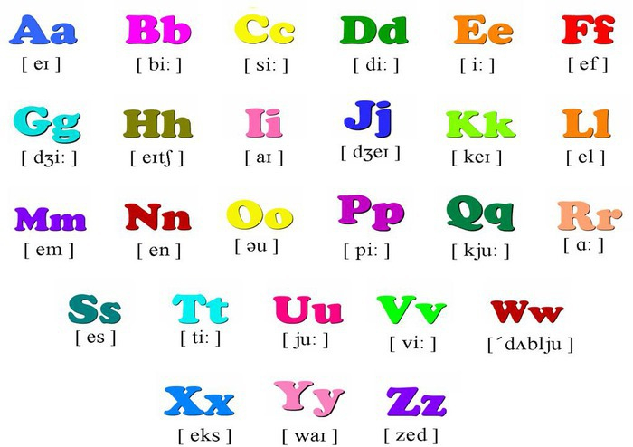

Slide 4
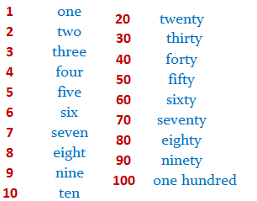

Slide 5
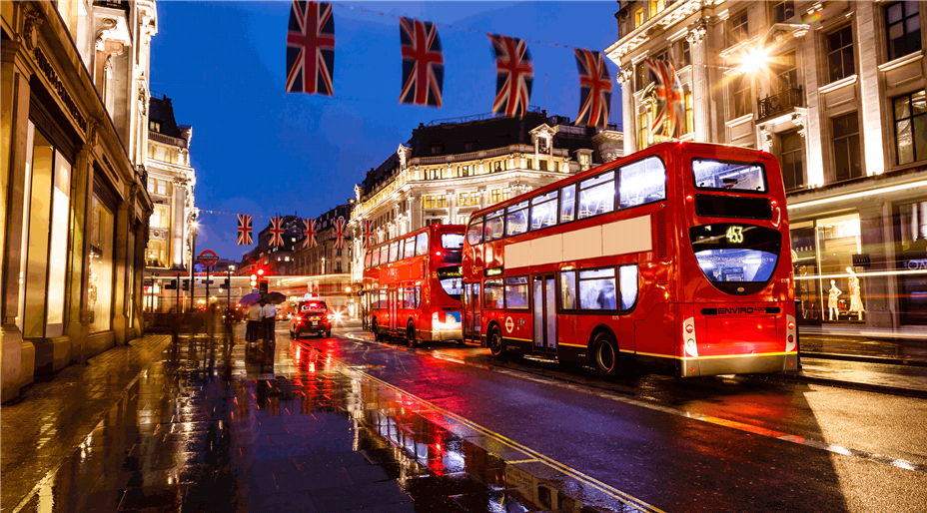
The Theme of the lesson is -
«Travelling»

Slide 6
The motto of the Lesson is :
"The world is a book, and those who do not travel, read only a page."

Slide 7

Phonetic drill

Slide 8
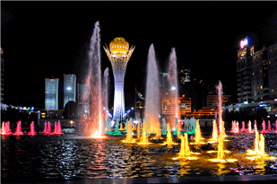
England
Kazakhstan
Russia Astana
America New York
China Moscow
London

Slide 9
The Baiterek
The Astana Aquarium
The Khan Shatyr
The London Eye
Big Ben
London Bridge
Buckingham Palace

Slide 10
Checking up homework p 54-55 ex 2

Slide 11
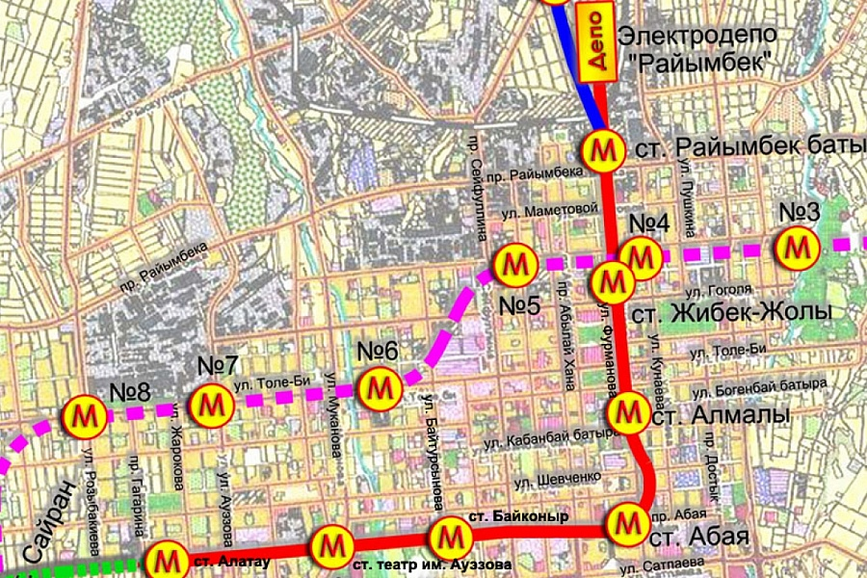
Metro in Almaty

Slide 12
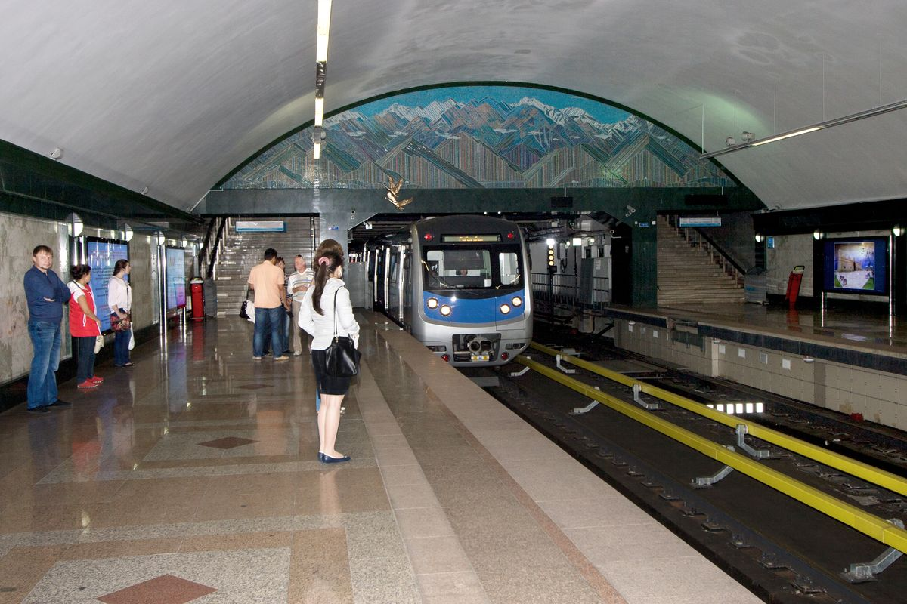
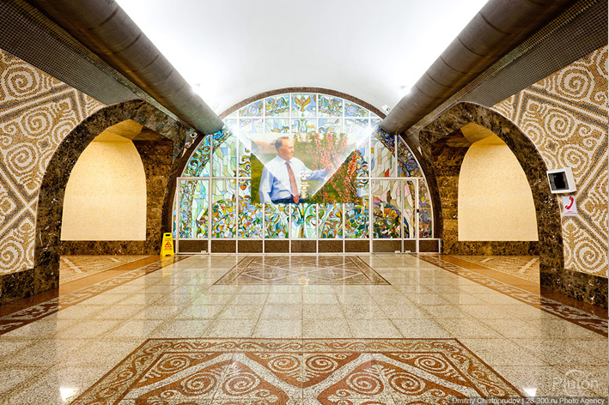
Metro in Almaty

Slide 13
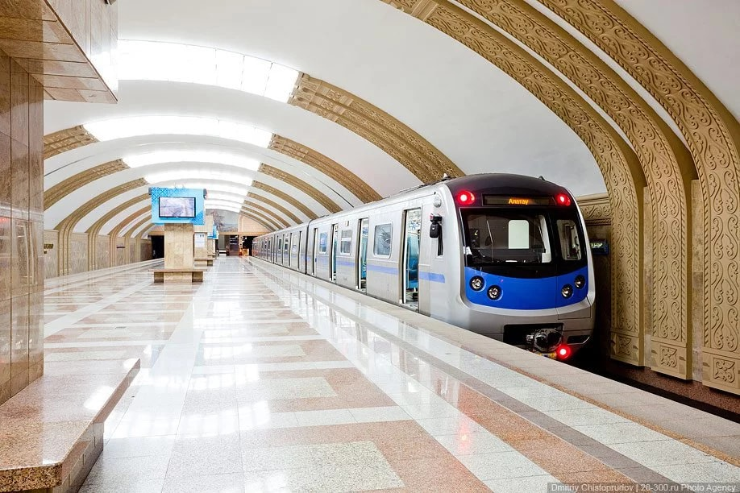
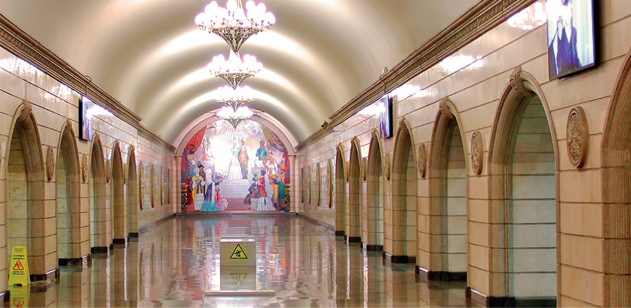
Metro in Almaty

Slide 14
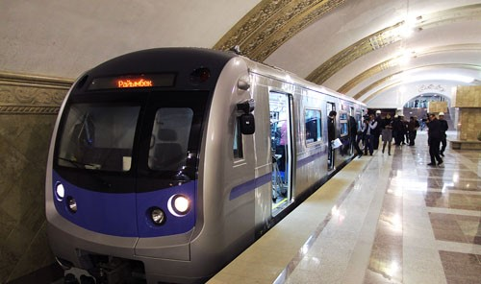
Metro in Almaty

Slide 15
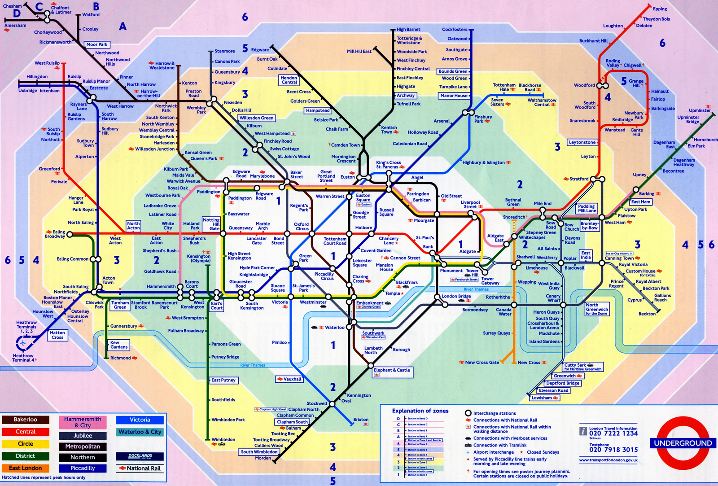
The metro map

Slide 16
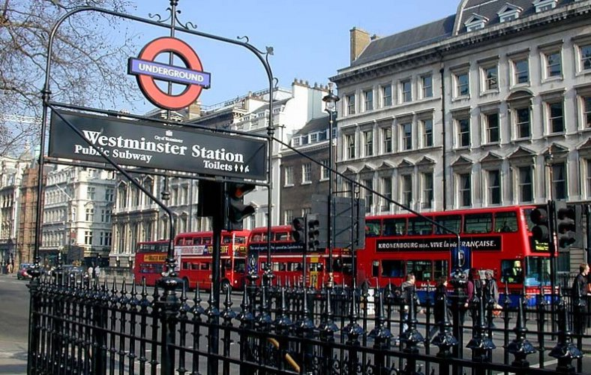
Metro in London

Slide 17
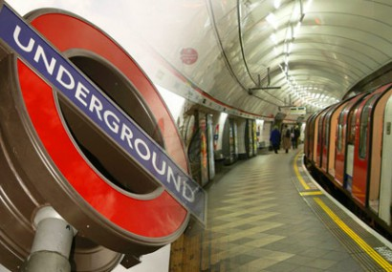
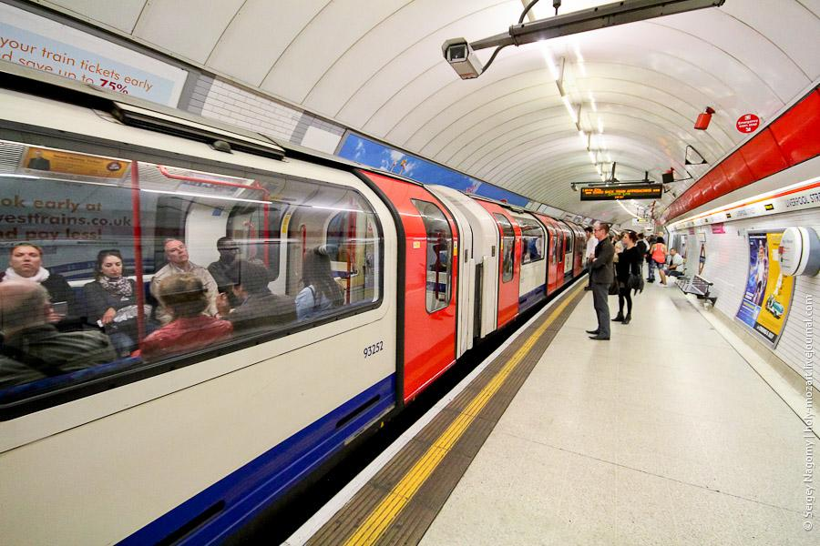
Metro in London

Slide 18
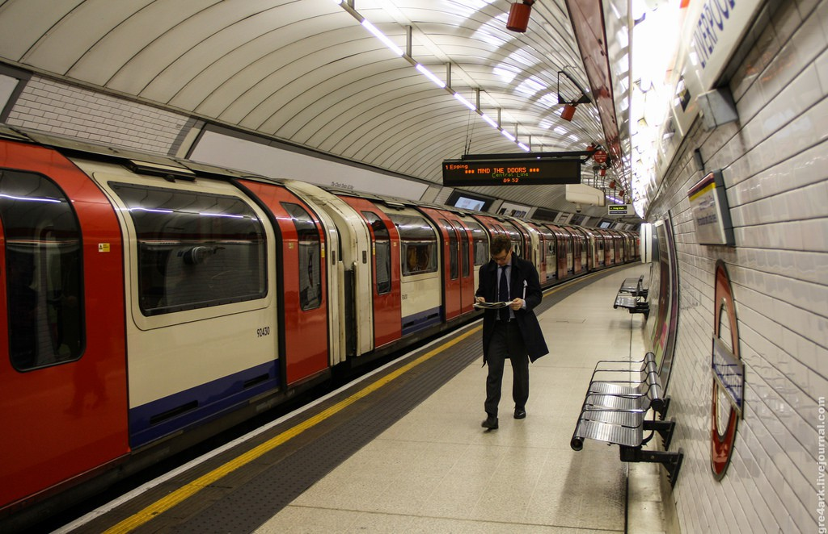
Metro in London

Slide 19
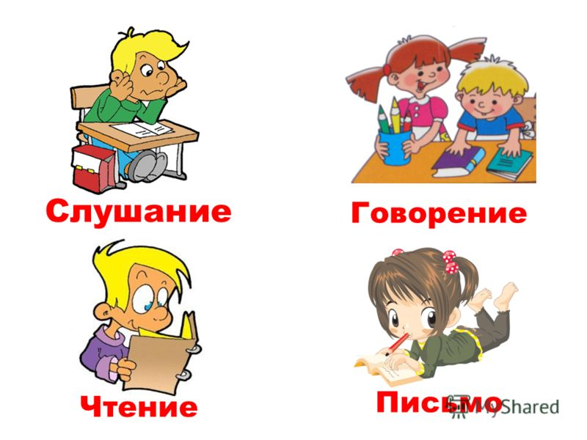
Listening track 41 p 54

Slide 20
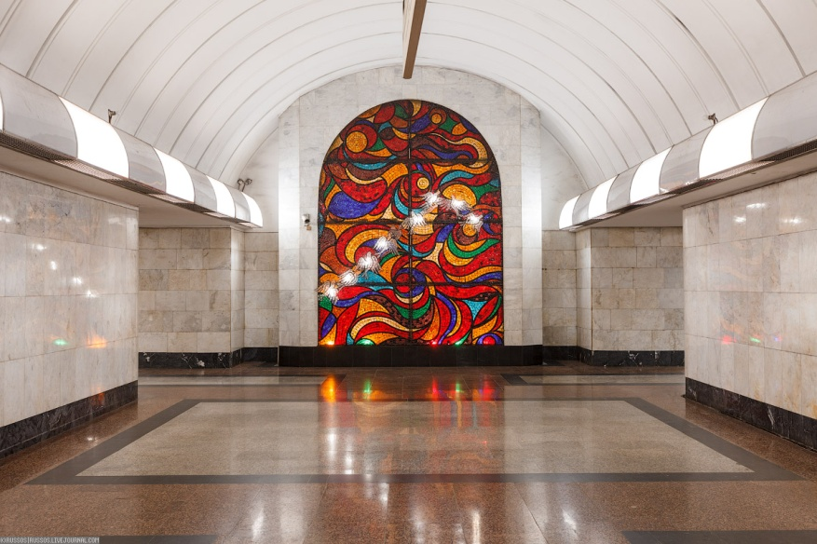
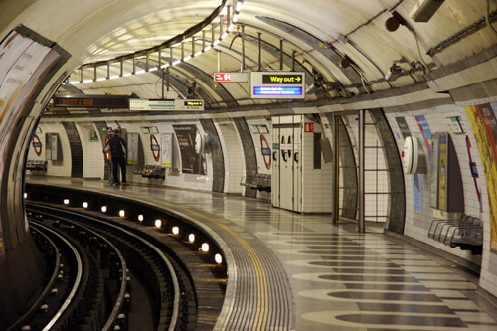
Reading p 54-55
The metro in Kazakhstan
The metro in London

Slide 21
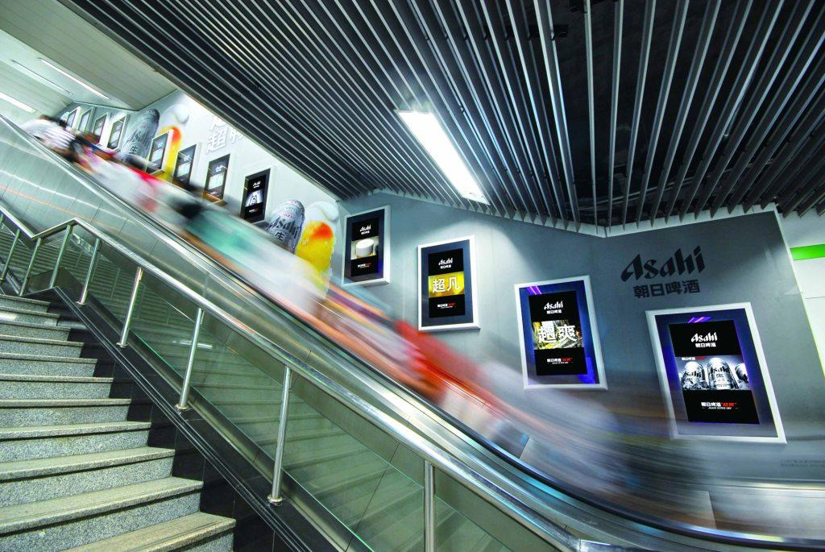
Answer the questions ex 3 p55

Slide 22

Physical drill

Slide 23
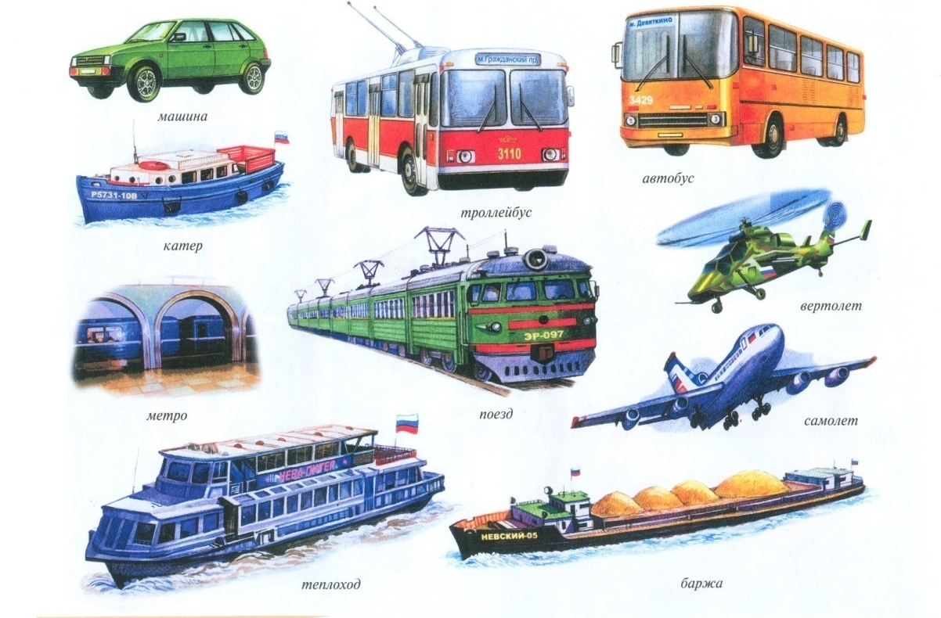
Video
Kinds of Transport

Slide 24
Kinds of transport:
a train
a plane
a ship
a bike
a tram
a metro
a taxi
a car
a bus

Slide 25
Rule:
We use the preposition «by» before Kinds of transport:

Slide 26
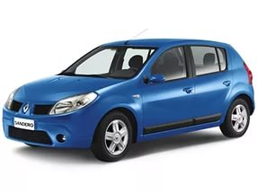
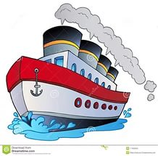

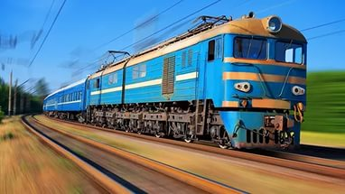
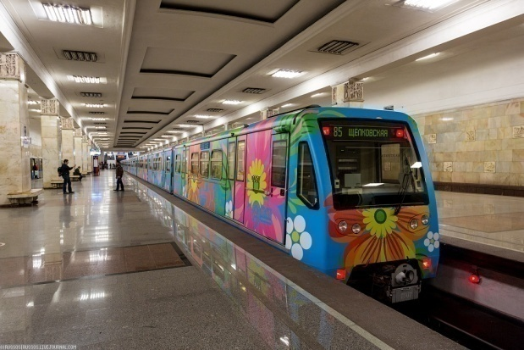
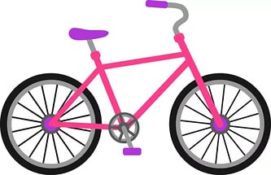
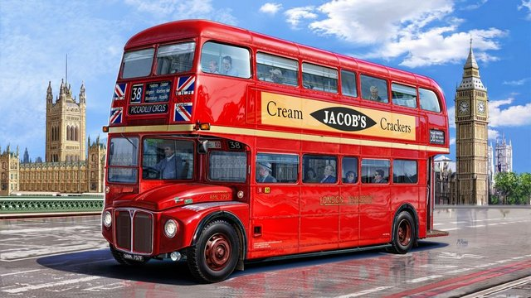
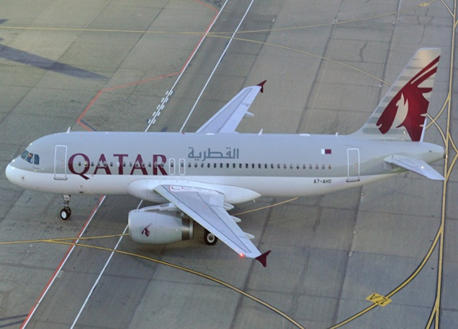
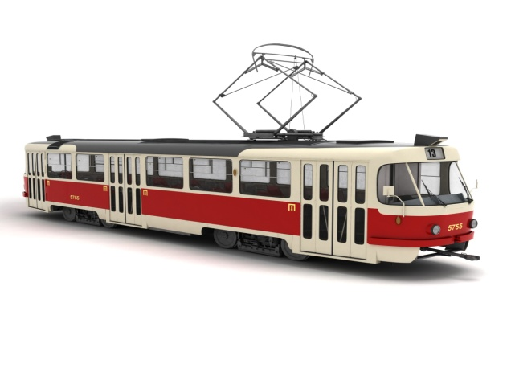
by train
by plane
by ship
by bike
by metro
by taxi
by bus
by car
by tram

Slide 27
Write the missing letters: by t.ain by pl.ne
by s.ip by bi.e
by met.o by t.xi
by b.s by ca.
by tr.m

Slide 28
Check yourself :
by train by plane
by ship by bike
by metro by taxi
by bus by car
by tram

Slide 29
Listening ex 2 track 42

Slide 30
Reading speaking practice ex 2

Slide 31
I can go to Kazakhstan by train

Slide 32
1. How can you go to China?
- I can go to China by plane.
2. How can you go to Russia?
- I can go to Russia by train.
3. How can you go to New York?
- I can go to New York by ship.
4. How can you go to Moscow ?
- I can go to Moscow by car.

Slide 33
Writing practice
1. I can go to… by train. ( ship, dog, Russia.)
2. We ….go to China by plane. ( there, museums, can )
3. You can go to London by….. ( ship, friend, river )
4. We can go to England ….bus. ( on, by, in )
5. You can …to Kazakhstan by car.(eat, go, fly)

Slide 34
KEY:
1 – Russia
2 – can
3 – ship
4 – by
5 - go

Slide 35
Marks :
0 – «5»
1 – «4»
2 – «3»
3 – «2»

Slide 36
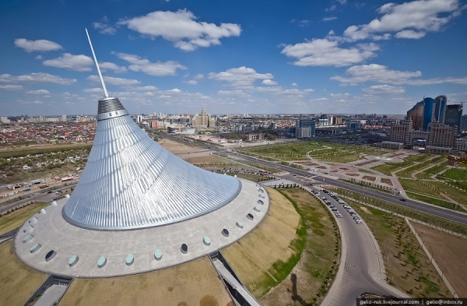
The Khan Shatyr

Slide 37
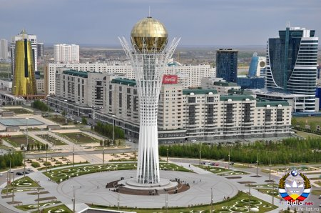
The Bayterek

Slide 38
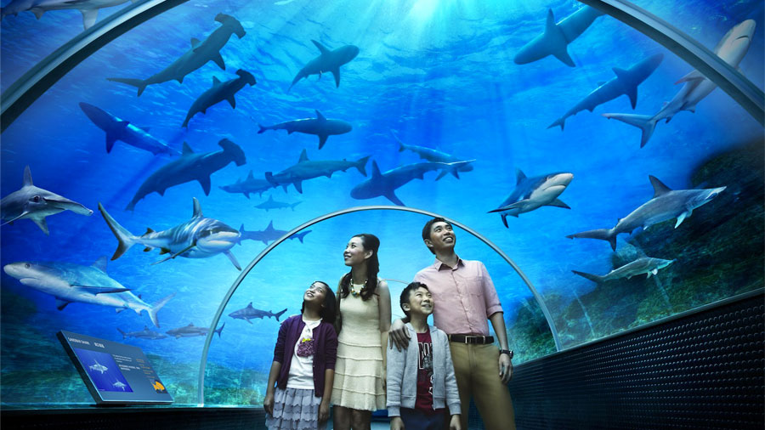
The Astana Aquarium

Slide 39
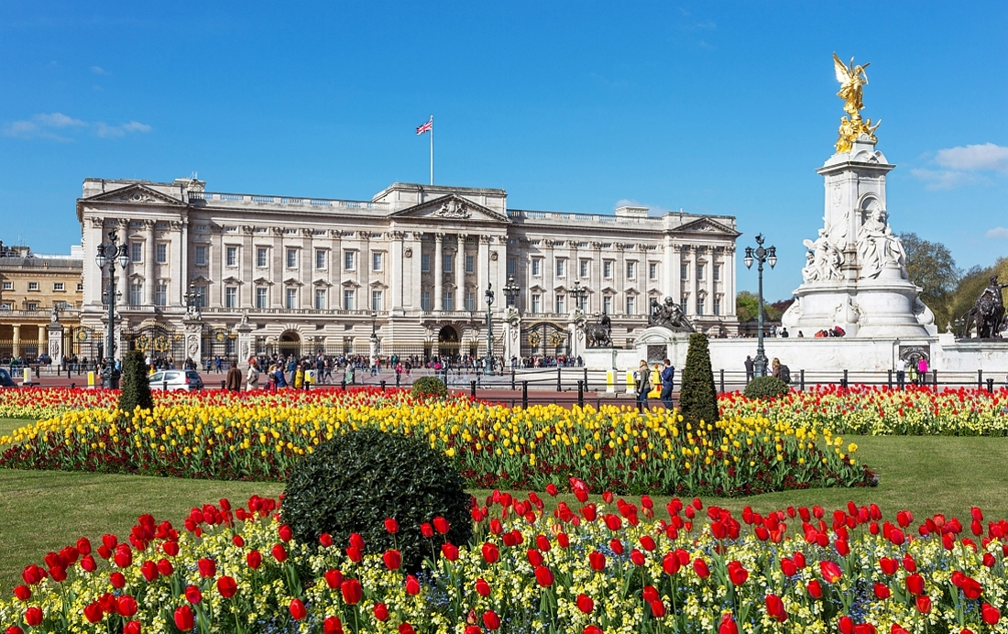
Buckingham Palace

Slide 40
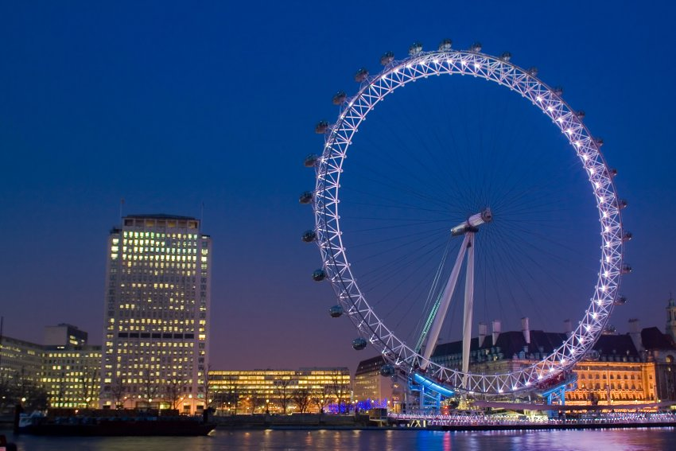
The London Eye

Slide 41
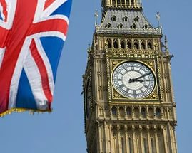
Big Ben

Slide 42
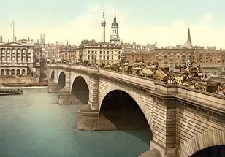
London Bridge

Slide 43
English proverbs
East or West home is best.
There is no place like home.

Slide 44
Homework
Workbook ex. 5, р. 53
р. 106 - new words

Slide 45
Writing Practice
You……

Slide 46
A song
Travelling

Slide 47


The lesson is over!
Goodbye!

Slide 48

Thank you!

