Slide 1

MUSIC

Slide 2
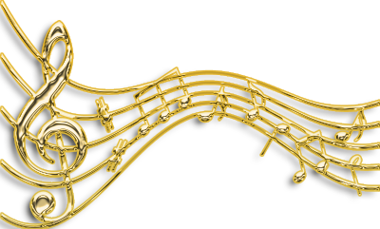
MUSIC
The 1st group is called “Musical instruments”,
The 2nd group is called “Musical genre” ,
The 3rd group is called “Melody”

Slide 3
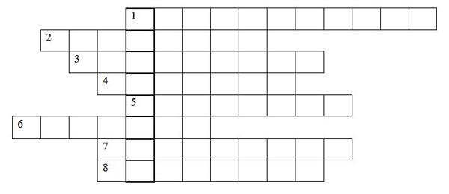

Fixing the material
“Musical instruments” | “Musical genre” | “Melody”
Puzzle | “Magic square” | Name the composers ____________________ ____________________ ____________________________________ __________________________________________________________________________________________

Slide 4
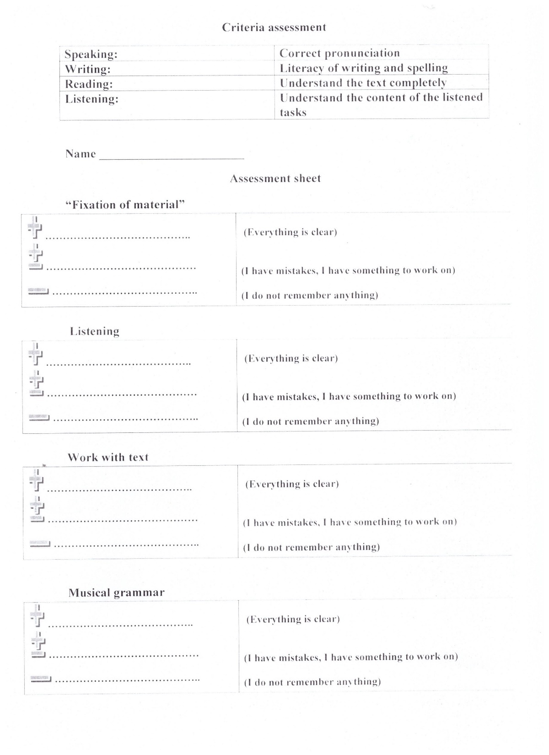

Slide 5

“Musical glade”

Slide 6

Quiz
What Kazakh instruments do you know?
How many notes in the musical notation?
The biggest instrument of the world is the ….
The most different instrument is the …
Translate the word “Hymn” in Kazakh
Translate the word combination into Kazakh “Musical instrument”
Name one English composer

Slide 7
Listening
Music | Rock | Jazz | Pop | Folk | Classical | Rap
№

Slide 8
Listening
Music | Rock | Jazz | Pop | Folk | Classical | Rap
№ | 4 | 1 | 3 | 2 | 5 | 6

Slide 9
Read the text. Mark the statements True (T) or False (F)
P1. Music is not just entertainment. It is medicine for both the brain and the body. Don Capable is an expert on The Mozart effects and the incredible power of music. He says that all kinds of music, from Mozart to jazz, from Latin to rock can affect our learning and our health.
P2. Many people use music to help them feel relaxed after a busy day at work. Music can also reduce the stress of being ill, especially by reducing pain. The director of Baltimore Hospital says that thirty minutes of classical music has the same effects as ten milligrams of the painkiller Valium.
P3. Campbell also says that music can help you concentrate but you need the right kind of music for your mood. And you need to listen for about ten minutes before you start studying.
P4. Music helps you to study and it can also make you intelligent. It one study, students who listened to Mozart before doing a test got high marks. Many studies show that children who learn to play a musical instrument before the age of twelve have a good memories.

Slide 10
True (T) or False (F)
Music is good for our bodies and brains __________________
Don Campbell loves Mozart’s music ____________________
Music helps many people to relax after work________________
Listening to music before you study is a bad idea______________
Only Mozart’s music helps you study________________________
It’s a good idea for children to learn to play a musical instrument ________

Slide 11

The hot chair

Slide 12
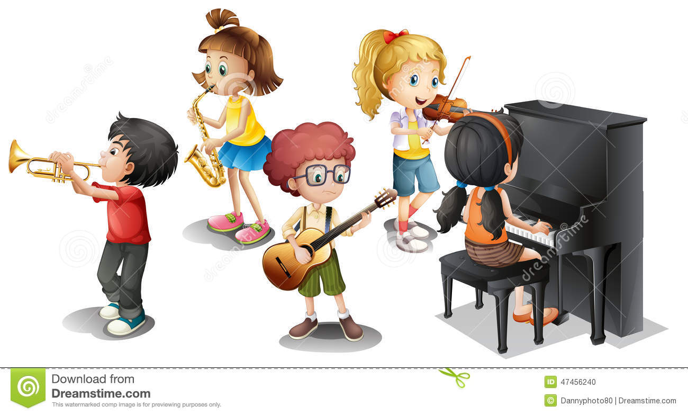
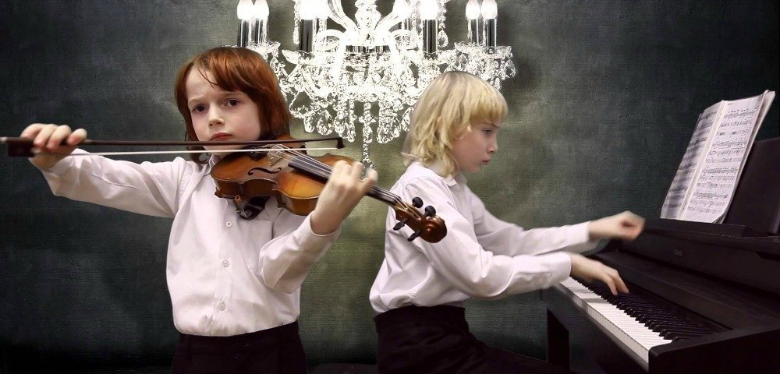
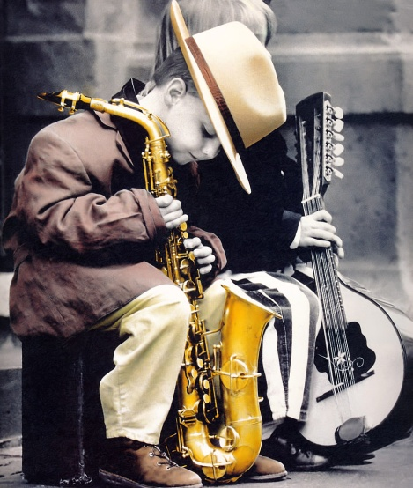

“Describing the picture”
2
1
3

Slide 13
Vocabulary work
To listen to [ ˈlɪsn ] слушать
To sing [sɪŋ] петь
To play |ˈpleɪ| играть
To dream [driːm] мечтать
To relax [rɪˈlæks] расслабиться
To dance [`dæns] танцевать
To reflect |rɪˈflekt| отражать
To choose |tʃuːz| выбирать
To rest [rest] отдыхать

Slide 14

“Musical grammar”
Consolidation of the
Past Simple. 3
When we use Past Simple?

Slide 15
MUSIC

